Slide 1
Film Analytics
D A T A D A W G S
Siddhant Sutar, Dalton Childers, Neil Matin, Abhimanyu Tomar

Slide 2
INTRODUCTION
‣ Every year, hundreds of movies are made in USA, with billions of dollars spent in their making and they also gross a huge amount of money.
‣ The Internet Movie Database (IMDb) is an online database that has a weighted mean-rating system for rating movies on a 10-point scale.
‣ For production houses, having a system that could give them possible ratings for a movie based on actor(s), director(s), genre(s), etc. could be of huge value to analyze the cost-benefit of investing in a movie.
‣ Film Analytics, is a project aimed at predicting IMDb movie ratings based on features like actor(s), director(s), genre(s), and plot keyword(s).

Slide 3
DATA
‣ Dataset: Movie data for ~1.1 million movies obtained from OMDb, stored in a csv file (size: ~500mb).
‣ However, the API does not support the retrieval of box office data. We used Regex and urllib2 to personally web scrape the box-office data from iMDB.
‣ Only movies from the USA were used, since a lot of other movies don’t have all the required fields updated on IMDb.
‣ Thus out of a total of 1103922 movies, 71565 movies were taken for our model.

Slide 4
STATISTICS
‣ Total movies: 1103922
‣ Movies in our model (USA only): 71565 (training + test)
‣ Actors: 76440 (training)
‣ Directors: 20962 (training)
‣ Plot keywords: 60376 (training)
‣ Movies with box-office budget data: 15556 (training + test)
‣ Movies with box-office gross data: 4205 (training + test)
‣ Movies with box-office data: 4201 (training + test)

Slide 5
MACHINE LEARNING
‣ For our project, we have particularly delved into understanding about two machine learning algorithms to learn about the predictive improvements:
Multiple linear regression
Ordered logistic regression

Slide 6

LINEAR REGRESSION
‣ Simple linear regression is an approach for predicting a quantitative response using a single feature (or "predictor" or "input variable"). It takes the following form:
What does each term represent?
y is the response
x is the feature
β0 is the intercept
β1 is the coefficient for x
Together, β0 and β1 are called the model coefficients. To create our model, you must "learn" the values of these coefficients. And once we've learned these coefficients, we can use the model to predict the iMDB movie ratings.

Slide 7
MULTIPLE LINEAR REGRESSION
‣ Simple linear regression can easily be extended to include multiple features. This is called multiple linear regression:

Slide 8
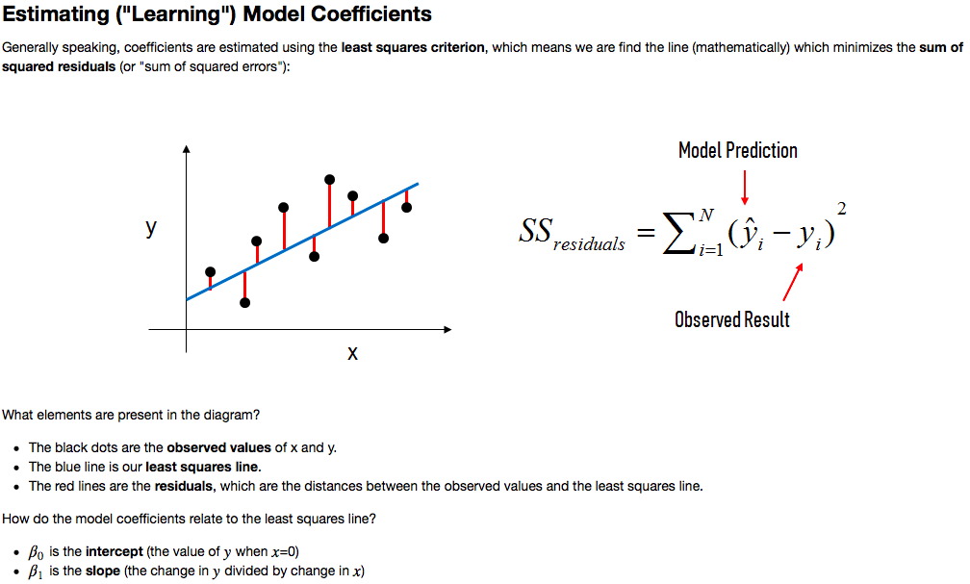
ESTIMATING MODEL COEFFICIENTS

Slide 9
VARIABLES
‣ Independent variables (features):
Genre(s)
Director(s)
Actor(s)
Plot keyword(s)
‣ Dependent variable (outcome):
IMDb rating

Slide 10
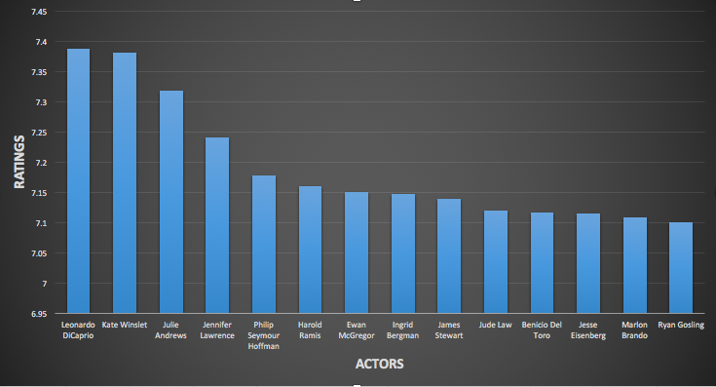
TRENDS - ACTORS
‣ Actors with the highest feature coefficients:

Slide 11
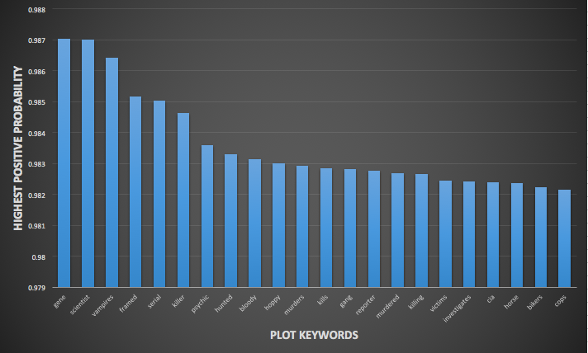
TRENDS - PLOT KEYWORDS
‣ Plot keywords vs highest positive probability (using Naive Bayes):

Slide 12
LINEAR REGRESSION MODEL
‣ Since all the independent variables here are categorical, not continuous, need to convert the categorical variables into a form that “makes sense” to regression analysis.
‣ All the independent variables are categorical; this is also known as an analysis of variance (ANOVA).
‣ Basically need to numerically represent the categories of a variable, called dummy variables, data coded according to 0 and 1 scheme.
‣ Interpretation: transform a variable such as Rating, which consists of categorical variables such as PG-13, R, etc. into a feature matrix with scores of 1 and 0 that can be analyzed with regression.

Slide 13
LINEAR REGRESSION MODEL
‣ Using Pandas get_dummies() function, create feature vectors for the independent variables: rating, genre(s), director(s), writer(s), actors. For example, a typical feature vector for actors would be a dataframe that would have movie IDs as rows and list of actors (from the movies in the dataset) as columns (dummy variables). If a specific actor was present in a specific movie, their intersection would have value 1; 0 otherwise.
‣ Concatenate the feature vectors to the original dataframe which has the loaded csv data.

Slide 14
LINEAR REGRESSION MODEL
‣ Import scikit-learn module, instantiate the linear regression model and “fit” the x and y dataframes corresponding to the user-specified feature columns and the outcome prediction column.
‣ For example, if the user entered “R”, “Quentin Tarantino”, “Leonardo DiCaprio” as the predictors, dataframe x would contain only those columns from the original dataset.
‣The x corresponds to x-axis which represents the independent variables, and the y corresponds to y-axis which represents the dependent variable in the following multiple linear regression equation:

Slide 15
LINEAR REGRESSION MODEL
‣ Cross-validation: for our analysis, we are using 70-30 training-test split.

Slide 16
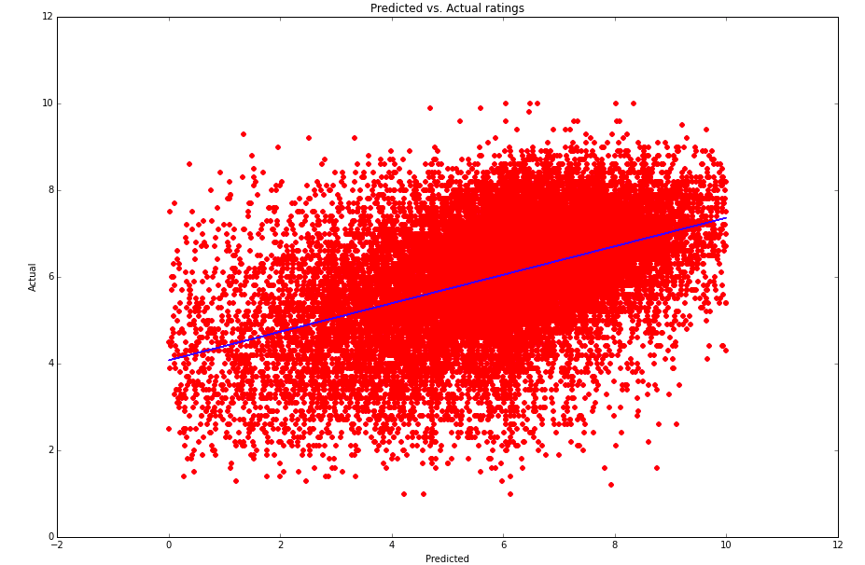
OBSERVATIONS

Slide 17
OBSERVATIONS
‣ Scatter points closely lying around the line of best-fit (blue line), indicating a strong positive correlation between the actual ratings and the predicted ratings.
‣ Root-mean-square error (RMSE): 0.2121
‣ Tolerance: 79%
‣ Standard Error: 0.0045
‣ Mean Squared Error (MSE): 3.1117
‣ Mean Absolute Error (MAE): 1.370

Slide 18
ISSUES
‣ Scaling: the outcome rating with certain predictors crosses the 10 point mark. Linear regression treats movie rating as a continuous variable (can go below zero or above ten), whereas essentially it is a categorical ordered variable.
‣ Hence the need to implement ordered logistic regression.

Slide 19
LOGISTIC REGRESSION
‣ Logistic regression deals with dependent variables that are categorical.
‣ Logistic regression measures the relationship between the categorical dependent variable and one or more independent variables by estimating probabilities using a logistic function, which is the cumulative logistic distribution.

Slide 20
ORDERED LOGISTIC REGRESSION
‣ Ordinal logistic regression (also known as ordered logit model) is a regression model for ordinal dependent variables.
‣ An ordinal variable is similar to a categorical variable, the difference lying in the fact that there is a clear ordering of the variables.

Slide 21
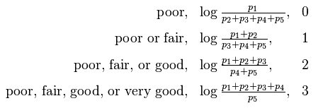
ORDERED LOGISTIC REGRESSION
‣ Let us consider an example. Say the proportion of members of the statistical population who would answer poor, fair, good, very good and excellent are p₁ , p₂ , p₃ , p₄ and p₅ , respectively. Then the logarithms of the odds of answering in certain ways would be:

Slide 22
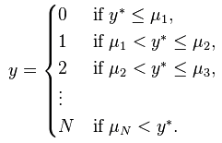
ORDERED LOGISTIC REGRESSION
‣ Suppose the underlying process to be characterized is:
where y* is the exact but unobserved variable, x’ is the vector of independent variables and β is the vector of regression coefficients. We cannot observe y*, only the categories:
Then this technique uses observations on y which are a form of censored data on y* to fit the parameter vector β

Slide 23
LOGISTIC REGRESSION MODEL
‣ The basic framework of the model is the same as the linear regression model: creating feature vectors for the categorical independent variables.
‣ The only change is the fact that the iMDB ratings are treated as an ordered categorical variable instead of a continuous numeric value.
‣ The order is as follows:
0 = [0, 5), 1 = [5, 6), 2 = [6, 7), 3 = [7, 8), 4 = [8, 9), 5 = [9, 10]
‣ Scikit-learn or even any other prominent machine learning libraries such as Statsmodel do not support a standalone module for ordered logistic regression yet.
‣ We are using a user-written ordered logistic module (made by Fabian Pedregosa, obtained from his GitHub repository).

Slide 24
CONCLUSION
‣ We have to consider some more machine learning models to get an estimate of which one will be the best for our predictor.
‣ Also, we have in mind that adding more relevant features (like time of release, budget, etc.) could possibly help the model predict more accurately.
‣ Adding reviews, social network data and Google trends could possibly help us get a better idea about how to analyze these trends.
‣ We can possibly try expanding movies beyond only USA, provided complete information is present in the database.

